Slide 1
Newport County AFC Supporters Trust Rewards & Benefits Scheme

Slide 2
How the Scheme will work
Monthly Direct Debits – administered by GoCardless
Discount Card for all contributors
Each card will have a unique membership number
New Benefits added every month
Funds ‘ring-fenced’ for Player Fund
Monthly newsletter for members

Slide 3
Card Details

Slide 4
How to join
Joining the scheme is easy and can be completed in minutes online. In order to join please access through the Trust website (details below)
http://www.ncafctrust.org/
In addition to being able to join on line forms will also be available for all supporters at the home game against Doncaster Rovers on the 10th February.

Slide 5
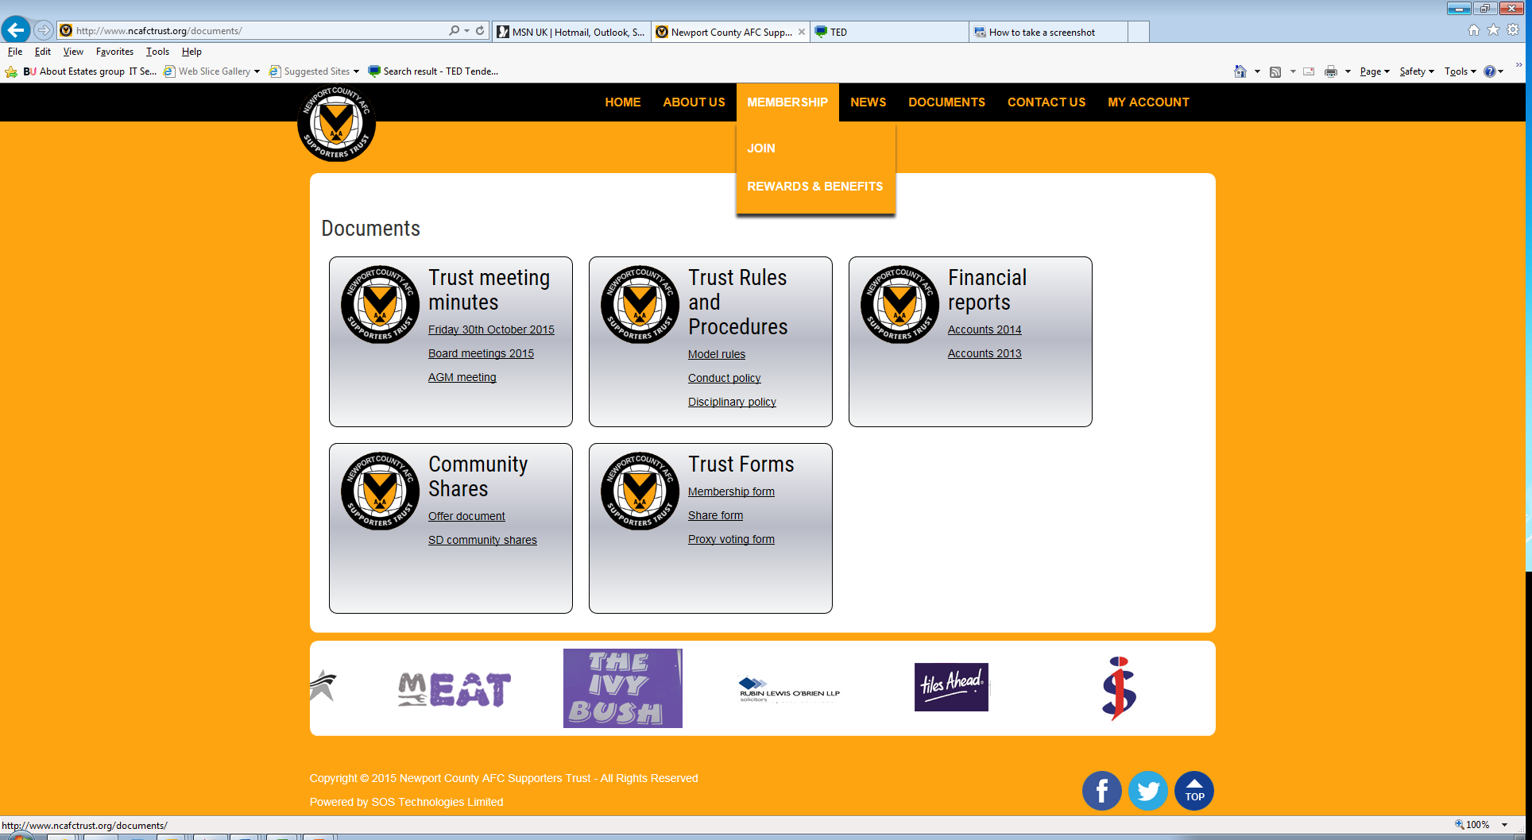
How to join

Slide 6
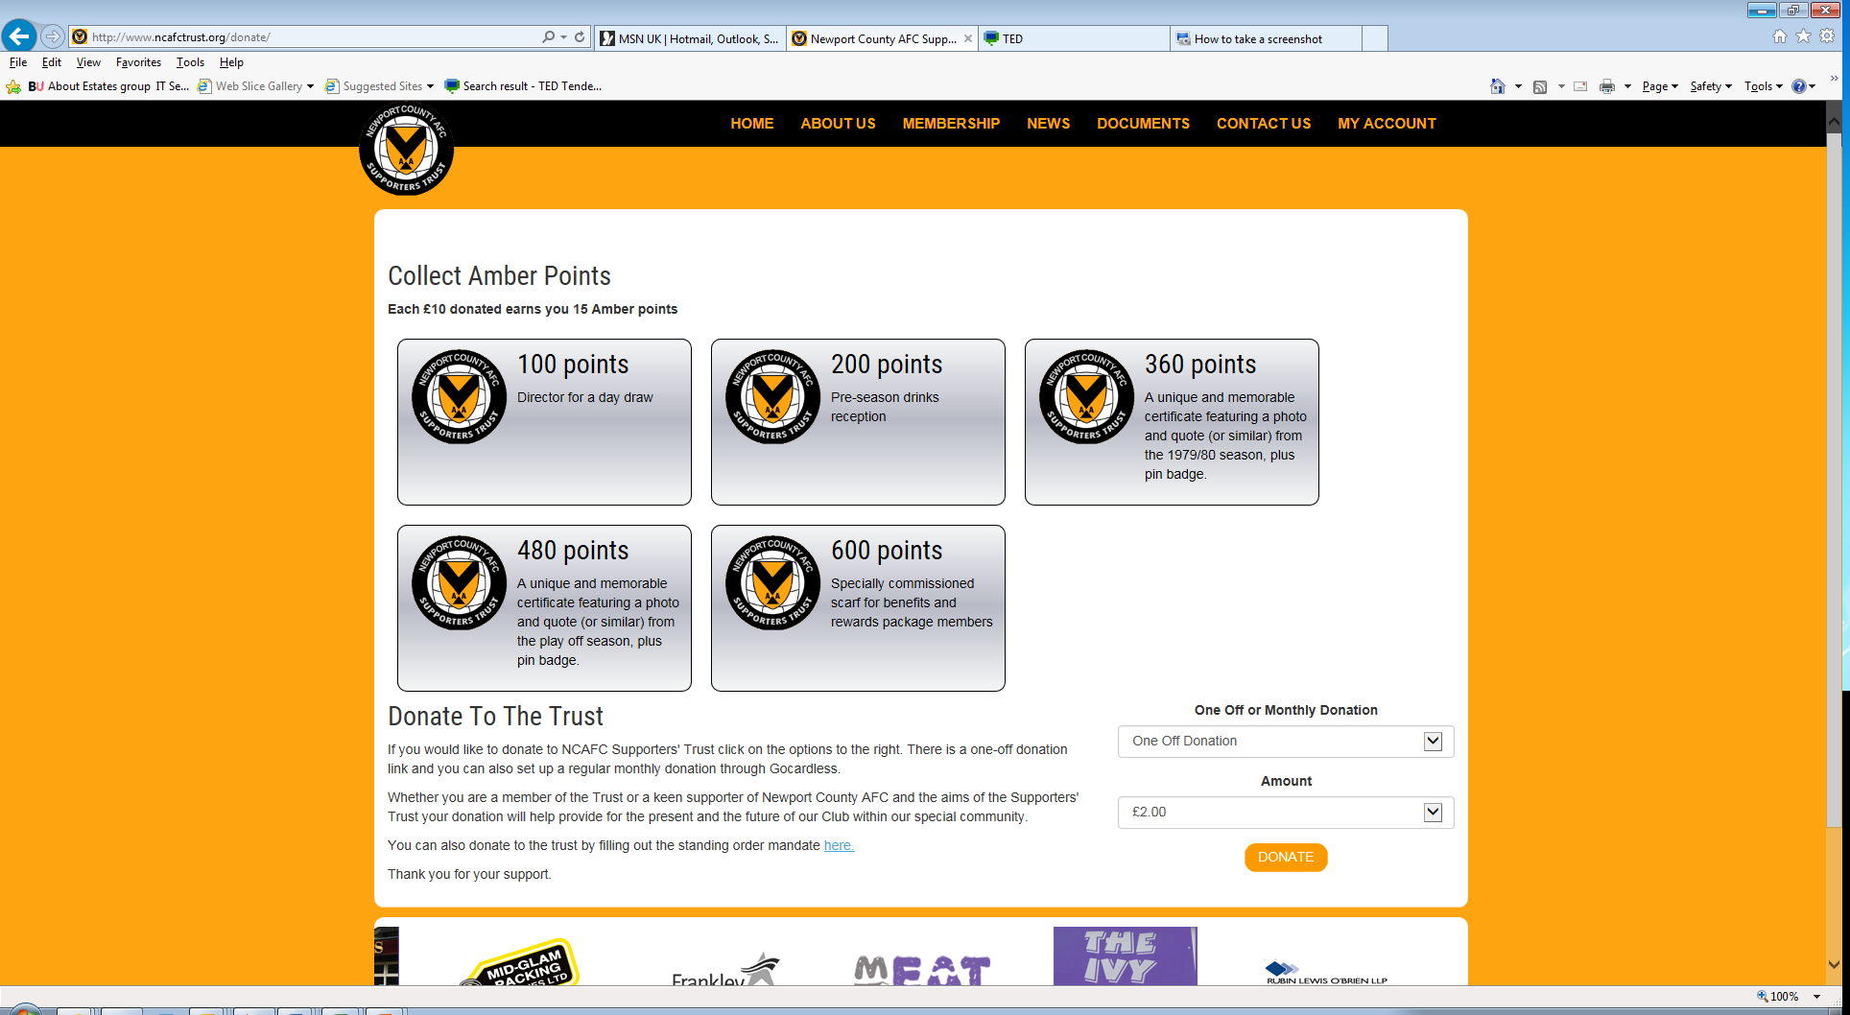
How to join

Slide 7
Discount Card Benefits

Slide 8
Further Details
For further information of the scheme please contact our Commercial Manager either by phone or email.
Telephone: 01633 481896
Mobile: 07972 541966
Email: james.watts@newport-county.co.uk

